Slide 1
VMware vFabric – Kick Start

Slide 2
Vmware vFabric -In a Nutshell
VMware’s cloud application platform solution
Application infrastructure for the cloud generation of applications.
Is comprised of Spring and new VMware vFabric product family: Modern application framework and integrated platform services
Maximizes speed and innovation
Extends the benefits of virtualization to the application
Notes:
What is Vmware Vfabric?
It is basically a platform for cloud-based applications. It provides an infrastructure for the cloud generation of applications or legacy applications that want to migrate to the cloud easily.
It is comprised of Spring which provides a modern application framework and a whole new product family of vfabic which provides a high integrated platform of services. What does this mean? Essentially. App, messaging,caching,storage etc

Slide 3
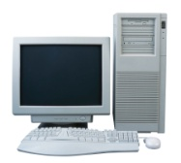

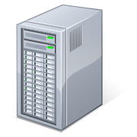

Transitioning from the Old to the New
Traditional IT
New IT - PaaS
Portable
Productive
Build:
Web Servers/Load Balancers
Java
Spring
+ Blueprint
App Servers
Google AE
Public
VMForce
Cache Servers
Messaging
Public/Hybrid
PaaS Pool
Problems:
Time
Cost
Static
IaaS – vSphere/vCD
Provides:
Self-Service
Optimization of Resources
Dynamic
Database
Notes:
In a traditional application development approach, a line of business decides they have need of some new capability that will improve business operations, revenue, … whatever. They commission the construction of a new system, and at this time, the LOB IT group will then look at the budget they have, scope the work, then begin procuring hardware and software for at least the development environment, and, if they are forward thinking, will commission the production and staging environments as well so that they can cut down on the months of work involved in physically provisioning hardware, network, security, software packages, databases, etc. In this example, the customer is looking to build a system that requires 11 servers that deliver appropriate capabilities required by the application. The physical approach is costly, in that this environment is replicated in dev/stage/and production, it is very costly. If you are the development lead on this project, and your job depends on your ability to deliver an application that performs and never fails, how much hardware/software/bandwidth, etc. are you going to buy? Answer: All of it! You will look at the budget you are given, and you will overprovision everything that you can to make sure that nothing breaks, there is redundency at every layer, etc. This is why customers have spent so much on heavy-weight infrastructure! It is costly, but I have way too much storage, way too much disc, way too much RAM, CPU, fans, bandwidth, etc. However, it is completely static. If you do run out of capacity in this environment, can you save the environment from denying requests by dynamically scaling? No. If you decide that IBM will give you a better price on application infrastructure than Oracle will, can you easily pick up your application and run it in a new environment? Not using traditional development approaches. If you dedicate yourself to a traditional vendor’s tools and development approaches, then you will find yourself bound to a particular application stack.
<Click> So, what VMware is driving towards is a more portable and productive development paradigm that can not only deploy to that traditional IT approach, but can effectively deploy to an internal cloud of server resources, or a public or hybrid cloud. <Click> This paradigm is Spring. When developers build applications using Spring, then they can deploy their code almost anywhere. You can run Spring in Oracle, in IBM, in RedHat, in open-source, even in .Net. As opposed to the previous approach, CIOs can make strategic decisions about deployment platform changes without overwhelming cost, as Spring can literally be lifted from one platform, and dropped into another. This portability allows for transparency of the underlying implementation and allows for a new kind of infrastructure.
Remember how overprovisioned the old way of doing business was? When the CIO is looking at cloud, your requirements for infrastructure change. You are no longer interested in overprovisioning, you are focused on optimal utilization of the available resources. That means, you are no longer interested in deploying gigs of infrastructure when only megs are needed. Leveraging virtualization, and this lighter weight approach to infrastructure, IT can move more towards self-service provisioning by requesting sets of virtual machines to run tests, to spin up development environments and then give the resources back to the pool for someone else. What does this do to cost when several development shops leverage the same set of hardware rather than build out distinct environments? What does that do to cost? What does that mean in terms of faster time to market? I can now look to dynamically scale as provisioning virtual resources is trivial compared to physical.
Questions?

Slide 4


Use Case: App Intelligence for “Just-in-Time” Infrastructure
Hotel room promotion comes online
Users are booking rooms
Hotel room promotion ends
Traffic
PST | 8 am | 9 am | 10 am | 11 am | 12 pm | 1 pm | 2 pm | 3 pm | 4 pm | 5 pm
Policy-based Capacity
Notes:
This Use Case is intended to illustrate the kind of applications and platform behavior that VMware’s Cloud Application Platform addresses:
The travel company has rolled out its new Hotel Booking application
In order to drive up bookings, they are running a special promotion that will only be available for 7 hours – from 9am to 4pm.
At 9 am, buyers start booking rooms at the special promotional rates.
If you don’t have a system to automatically handle increasing usage, your app will fall over and revenue will be impeded.
However, if you’re using VMware’s Cloud Application Platform, you can have the information necessary to automatically scale up application instances, meet the usage spikes, and enable the company to meet its revenue goals.
Conversely, as usage declines towards the end of the day, you can set the appropriate policy to automatically scale down app instances, freeing up virtual infrastructure for other needs, such as an Order Tracking application.
Since transparent insight into performance is able to gathered across the application and underlying infrastructure platform, you have the flexibility to set policy at whatever level of your application that is needed.

Slide 5

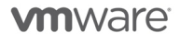
Application Infrastructure for the Cloud Generation
VMware vFabric Cloud Application Platform
Modern Frameworks and Tools
Developer Productivity and Application Portability
Frameworks and Tools
Modern Platform Services
vFabric
Optimized Runtime and Accelerated Deployment
Platform Services
Virtual Datacenter
Cloud Infrastructure and Management
Notes:
VMware’s Cloud Application Platform addresses the needs of BOTH developers and operations by combining market-leading developer frameworks and tools with integrated application platform services to deliver speed, portability, and optimized use of cloud resources.
The Modern Frameworks and Tools enable developers to build innovative new applications in a familiar and productive way while enabling the choice of where to run those applications (inside the datacenter or on private, hybrid, or public clouds).
The Modern Platform Services are much more agile and designed for virtualization. Unlike traditional middleware platforms, these platform services provide lightweight footprints that make the best use of the underlying virtual infrastructure platform as well as enable businesses to bring applications to market faster and with less complexity: new applications can be delivered in days or weeks rather than months or years, and at scale.
[CLICK]
These two layers in our cloud application platform are Spring family of frameworks and tools and the VMware vFabric family of platform services. Let’s take a look at these in a little more detail…

Slide 6


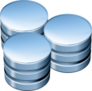






Innovation Reigns Supreme
Web
Batch
Mobile
Cloud Platform Services
Integration
Social Media
Security
6
Notes:
Today, Spring provides a common, productive programming model for developing robust [CLICK] Web, [CLICK] Batch, and [CLICK] Integration applications in a [CLICK] Secure manner.
Spring is actively working to provide an evolutionary path for these applications to the cloud, anticipating new requirements to extend these applications by:
Leveraging [CLICK] popular social media services and [CLICK] cloud service API’s, as well as
Providing a [CLICK] rich, modern user experience across a range of platforms, browsers and personal devices
Now we’ll take a quick look at some of the exciting reference architectures the Spring community is using to bridge their current Spring applications to successful deployment within the cloud.

Slide 7
Application Infrastructure for the Cloud Generation
VMware vFabric Cloud Application Platform
Modern Frameworks and Tools
Developer Productivity and Application Portability
Frameworks and Tools
Modern Platform Services
vFabric
Optimized Runtime and Accelerated Deployment
Platform Services
Virtual Datacenter
Cloud Infrastructure and Management

Slide 8








Is a New Style of Infrastructure Needed?
We need a platform that can Run these new apps.
Elastic App Server
Dynamic Load Balancing
Global Data Management
Performance Management
Developers & Architects
And… IT Operations
Cloud Messaging
Policy Driven Automation
Notes:
Now that the Developers have the necessary tools and frameworks to build the new hotel room booking application, they need a platform that can optimally run the application.
Modern platforms provide lighter-weight application runtimes, efficiently manage access to large volumes of data, and open up new ways for applications inside and outside the datacenter to communicate through:
[CLICK] Lightweight application server that can be instantaneously provisioned and elastically scaled
[CLICK] Data management platform that provides real-time access to globally distributed data
[CLICK] Cloud-ready messaging service that facilitates communications between applications inside and outside the datacenter
Moreover, modern platforms need to be built with performance in mind. By providing transparent visibility into the performance of the applications and underlying infrastructure, new levels of agility can be driven through policy-driven automation and application-level SLAs that drive proactive operational behavior through such services as:
[CLICK] Web server / load balancing service that is able to dynamically route requests to an application server for processing
[CLICK] Proactive performance management services powered by transparent visibility into applications and infrastructure
[CLICK] Policy-based configuration and provisioning services that automate the process of running and managing an application

Slide 9


Elastic Application Server: Lightweight Application Platform
JEE Server
tc Server
Tomcat
Heavyweight App Container
Lightweight App Container
Enterprise Capabilities
Enterprise Capabilities
(?)
tc Server is Enterprise Tomcat – The best of both worlds
Optimized for Cloud/Virtualization
Same great high performance, low complexity, lean platform (10 MB Server)
Best platform to run Spring (or any non-EJB Java) applications on
Has Features/Capabilities Enterprises need and expect
Management, Monitoring, Diagnostics, Support
Notes:
If you remember the picture we spoke about at the beginning, traditional IT has loved heavyweight enterprise application servers. These servers are required to host applications. Traditional JEE servers are very large engines that provide a large number of enterprise capabilities (such as monitoring, management, support, etc.). Because of these command and control capabilities, IT Ops has favored these large engines of enterprises past. On the opposite end of the spectrum is this very lightweight container called Tomcat. Tomcat is free and a fraction of the size of JEE servers. As an example, WebLogic and WebSphere are both around a gig in size. Tomcat is around 9 meg. What VMware is doing with vFabric tcServer is bring all of these enterprise capabilities to the Tomcat application container. So, if you are deploying 1 instance of WebLogic to an HP Superdome, do you care that WebLogic requires a lot of CPU, memory, etc.? Not really. If you are looking to deploy 50 VMs to a more cost effective vBlock, do you want a huge WL instance in every VM? No way. It becomes imperative to drive more efficiency with a light-weight approach, especially if I can still get those enterprise capabilities. This is not even considering price, where tcServer is typically 1/10th the cost with a very strong long term TCO.

Slide 10



SpringSource tc Server: Key Highlights
Developer
Efficiency
Familiar Spring + Tomcat experience
Deep performance insight into Spring apps
Agile Spring development experience via STS
Performance & SLA management of Spring apps
Application provisioning and server administration
Rich alert definition, workflows, and control actions
Group availability & event dashboards
Secure unidirectional agent communications
Operational
Control
Lean server (10 MB) ideal for virtual environments
Template-driven server instance creation
Integrated experience with VMware environments
Open, secure API for all operations
Deployment
Flexibility

Slide 11


Deployment Flexibility: tc Server Instances (large physical box)
tc Server
Instance 1
tc Server
Instance m
tc Server
Instance X
. . .
Spring
Spring
Spring
Spring
Spring
tc Server ver X
(shared binaries)
. . .
tc Server ver Y
(shared binaries)
Operating System & JVM
Single lightweight (10MB) install for multiple running instances
Shared binaries eases upgrades of all instances
Separates configuration and code from server runtime
Multiple server versions can be installed per machine

Slide 12

Deployment Flexibility: tc Server Instances (virtualized platform)
Medium Virtual Machine
tc Server
Instance 1
tc Server
Instance m
. . .
Small VM
Small VM
Spring
Spring
Spring
Spring
tc Server
(shared binaries)
tc Server
tc Server
Operating System & JVM
OS & JVM
OS & JVM
Virtual Infrastructure Platform
Complete flexibility to deploy large, medium, and small “machines”
Lightweight footprint ensures maximum resource utilization

Slide 13
Is a New Style of Infrastructure Needed?
We need a platform that can Run these new apps.
Elastic App Server
Dynamic Load Balancing
Global Data Management
Performance Management
Developers & Architects
And… IT Operations
Cloud Messaging
Policy Driven Automation

Slide 14
GemFire
The GemFire is in-memory distributed data management platform that pools memory across multiple processes to manage application objects and behavior.
Caching
Querying
Transactions
Event Notification
Function Invocation
Notes:
The acquisition advances SpringSource’s vision of providing the infrastructure necessary for emerging cloud-centric applications, with built-in availability, scalability, security and performance guarantees. These modern applications require new approaches to data management, given they are deployed across elastic, highly scalable, geographically distributed architectures. With the addition of GemStone’s data management solutions, SpringSource customers can ensure the right data is available to the right applications at the right time within a distributed cloud environment
Distributed Data Fabric
Low Latency Elastic Data Grid (LAN, WAN)
Messaging
Active Event Notification
Active/Continuous Querying
Serves as data filter and event driver
With Continuous Availability
Supports disconnected, intermittent and low bandwidth networks
Highly Instrumented
----------------
Used by Navy in Trident Warrior 09 – experience 90% reduction in bandwidth used due to Continuous Query filtering
Used in CWID 08 and 09 and Coalition Fires 09 – show filtering and support for disconnected operations
Used in GCCS-J (Global Command and Control System – Joint)
For example, the JP Morgan Chase grid computing environment, called the compute back bone (CBB), consists of over 1,000 computers (8,000 CPU’s) in 2 countries. It uses GemFire as the data backbone for caching, data access, and data distribution. By using GemFire the customer realized between a 4x–and–10x speed up of applications, and increased overall data sharing across applications. Our software replaced their home grown caches and their legacy, database based, data distribution. A 4x–performance increase is like getting 3 free computers that consume no electricity, space or software licenses. If you are interested in getting 3 free computers that use no electricity or space, for every computer you have in your current server grid, then call us

Slide 15




GemFire
Your Java
Spring App
tc Server
Spring Edition
Hyperic &
Spring Insight
Built with
SpringSource Tool Suite
Trace, Monitor, Alert, Manage
Lightweight App Runtime
GemFire Enterprise
Distributed Data Fabric
Session & Object/Data Store,
Geo Replication & Partitioning, Active Queries & Notifications, …
GemFire Data Management
File Systems
Databases
Other Data Systems
Notes:
The acquisition advances SpringSource’s vision of providing the infrastructure necessary for emerging cloud-centric applications, with built-in availability, scalability, security and performance guarantees. These modern applications require new approaches to data management, given they are deployed across elastic, highly scalable, geographically distributed architectures. With the addition of GemStone’s data management solutions, SpringSource customers can ensure the right data is available to the right applications at the right time within a distributed cloud environment
Distributed Data Fabric
Low Latency Elastic Data Grid (LAN, WAN)
Messaging
Active Event Notification
Active/Continuous Querying
Serves as data filter and event driver
With Continuous Availability
Supports disconnected, intermittent and low bandwidth networks
Highly Instrumented
----------------
Used by Navy in Trident Warrior 09 – experience 90% reduction in bandwidth used due to Continuous Query filtering
Used in CWID 08 and 09 and Coalition Fires 09 – show filtering and support for disconnected operations
Used in GCCS-J (Global Command and Control System – Joint)
For example, the JP Morgan Chase grid computing environment, called the compute back bone (CBB), consists of over 1,000 computers (8,000 CPU’s) in 2 countries. It uses GemFire as the data backbone for caching, data access, and data distribution. By using GemFire the customer realized between a 4x–and–10x speed up of applications, and increased overall data sharing across applications. Our software replaced their home grown caches and their legacy, database based, data distribution. A 4x–performance increase is like getting 3 free computers that consume no electricity, space or software licenses. If you are interested in getting 3 free computers that use no electricity or space, for every computer you have in your current server grid, then call us

Slide 16

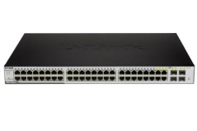
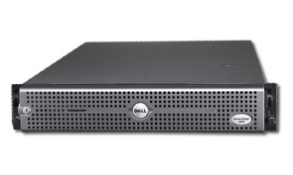



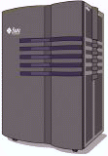
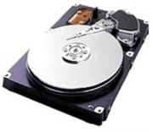
Scaling the Tiers
The web and application tiers can be easily combined and virtualized. Nodes can be added or removed on the fly.
Load Balancer
Add/remove web/application servers
Web Tier
Application Tier
The database only grows by moving the VM to a larger machine
Database Tier
The disk systems can be virtualized and can grow on demand
Storage Tier
Notes:
Traditional Three-Tier Architectures have provided scalability by forcing the Web and Application Tiers to be stateless, and have pushed all run-time state management down to the database tier. The Database Tier, in turn, has relied heavily on the Storage Tier to provide durability of the updates.
Virtualization has been applied successfully to the web and application tiers – they can be combined into a single virtual machine and deployed in an elastic fashion.
The database has been virtualized but virtualization is unable to resolve some of the inherent architectural problems in database design that prevents it from being easily distributed across multiple nodes. The few commercial products that do distribute the database across multiple nodes are expensive, have limited scalability and require extremely static hardware configurations (thwarting or preventing virtualization of these products). The only viable solution for database virtualization is to virtualize the database as a single node. When the database needs to scale, you can move this virtual machine onto a larger physical machine that can provide additional computational power to the virtual machine. This, unfortunately, is a very expensive option, and itself has limited scalability.
A survey of Public Cloud Providers revealed that they, in order to provide database functionality to their clients, had to set up separate, large machines ‘on the side’ of their clouds in order to run databases for their clients’ applications. Of course, the cost of these large machines was fully charged to the customer, breaking the ‘cloud model’ and limiting the financial benefit of the cloud to their customers. Large public cloud implementations also provide database function ‘as a service’ which is typically implemented as large, multi-tenant, database instances that run ‘on the side’. The latency between the cloud applications and these database ‘services’ is usually quite high and less predictable.

Slide 17
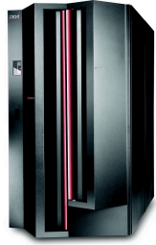

Legacy Database Clustering Strategies
Legacy database clustering technologies tend to be either:
A
B
C
D
Statically Partitioned
Failure of Server A will double workload on Server B
Failure of Server A and Server B makes some data unavailable
Rebalancing requires taking database offline
A
B
C
D
Shared Everything
All servers must co-ordinate activity
Must acquire distributed locks on data for update
Scalability is not linear and limited to a handful of nodes
Failure to synchronize activity can crash the entire cluster

Slide 18


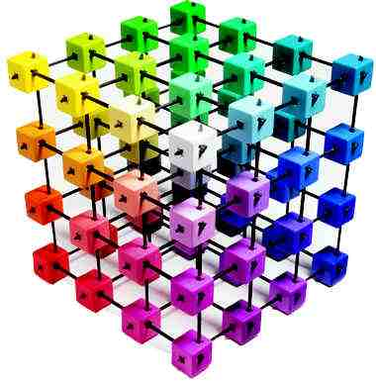
Linear Scalability
GemFire can achieve near linear scalability with nodes that can be added or removed on the fly.
Scale
Add/remove web/application/data servers
Disks may be direct or network attached
Web, Application and Data tiers can be collapsed into a single virtual machine.
Optional reliable, asynchronous feed to Data Warehouse or Archival Database
Notes:
GemFire virtualizes database functionality so that it can be combined with the Web and Application functionality into a separate tier. Now, this single virtual machine can be deployed elastically as demand for services grows or shrinks. Performance increases nearly linearly (due to GemFire’s partitioned architecture) as additional resources are added to the cluster.

Slide 19
SQLFire
Scalable SQL instead of NoSQL
Memory Oriented clustered database platform
Manage database tables entirely in memory
Use partitioning and synchronous replication across nodes
Overflow data to disk
SQLFire is implemented entirely in Java, and it uses robust VMware vFabric GemFire

Slide 20
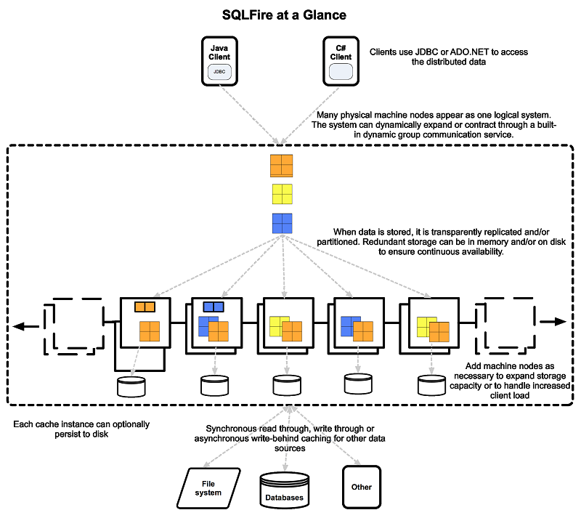

Slide 21
Is a New Style of Infrastructure Needed?
We need a platform that can Run these new apps.
Elastic App Server
Dynamic Load Balancing
Global Data Management
Performance Management
Developers & Architects
And… IT Operations
Cloud Messaging
Policy Driven Automation

Slide 22
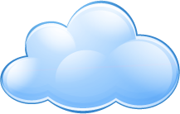






More Than Just Data – How do I Distribute Cloud Information?
Application Data Lives Here
Application Messaging That Won’t Fail
GemFire Data Fabric
RabbitMQ (AMQP) Message Bus
Application Data Sleeps Here
File Systems
Databases
Other Systems
Cloud Services
Applications
Devices

Slide 23
Basic use cases
Event
I need to know when to do something
Data fragment
I need to give you a piece of this data without you needing to understand the whole schema
Routing
Control who gets which message, without changing sender and receiver
Publish
Tell everyone who wants to know about this
Batch
Producer and consumer can run at independent times
Load share
Add more consumers to scale up

Slide 24
Who uses AMQP
Over 500 known commercial users recorded by AMQP vendors, examples:
National Science Foundation OOI Cyber infrastructure
Frankfurt Stock Exchange
“EUREX 12 is FIXML over AMQP Eurex is the very first exchange to introduce AMQP as a standard protocol on its system, thus easing the monitoring of positions and risk related data for its members and ensuring market integrity for all participants.”
JPMorgan sends 1 billion AMQP messages per day
60 production system (50% CAGR, unforced)
NASA’s Nebula Cloud Computing project
Second Life
Developer clouds: VMforce, Engine Yard, Joyent, Heroku

Slide 25
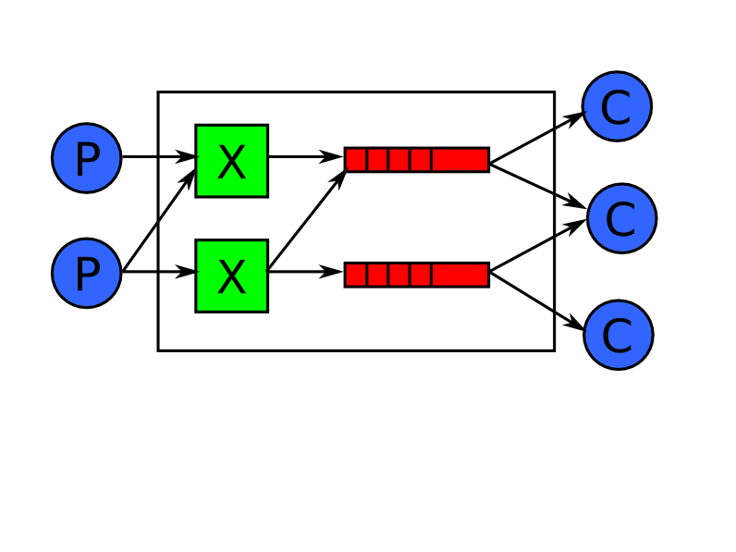
How AMQP works
Each message is stateless
Consumers create queues; these buffer messages for push to consumers
Queues are stateful, ordered, and can be persistent, transient, private, shared.
Exchanges are stateless routing tables.
Consumers tell queues to bind to named exchanges; each binding has a pattern e.g. “tony” or “*.ibm.*”
Producers send messages to exchanges with a routing key e.g. “tony”, or ordered set of keys e.g. “buy.ibm.nyse”
Exchanges route messages to queues whose binding pattern matches the message routing key or keys

Slide 26
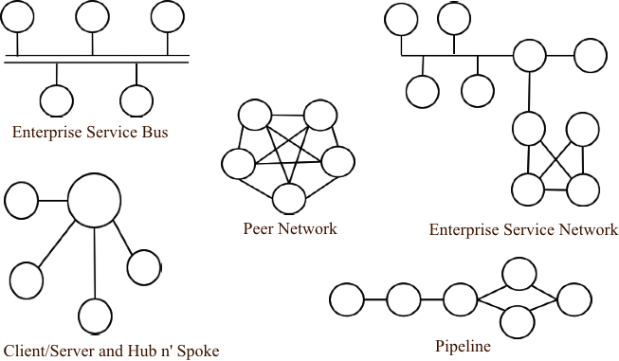
Architectures you can build with AMQP

Slide 27
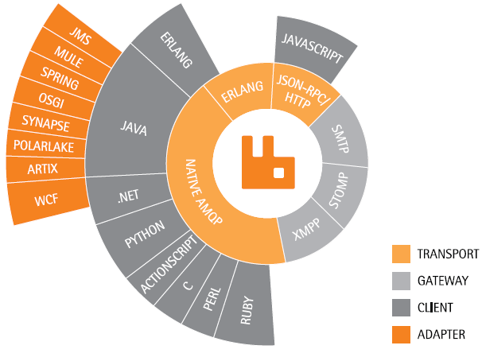
Rabbit is great for developers
Developer platform integration

Slide 28
Is a New Style of Infrastructure Needed?
We need a platform that can Run these new apps.
Elastic App Server
Dynamic Load Balancing
Global Data Management
Performance Management
Developers & Architects
And… IT Operations
Cloud Messaging
Policy Driven Automation

Slide 29
Is a New Style of Infrastructure Needed?
We need a platform that can Run these new apps.
Elastic App Server
Dynamic Load Balancing
Global Data Management
Performance Management
Developers & Architects
And… IT Operations
Cloud Messaging
Policy Driven Automation

Slide 30
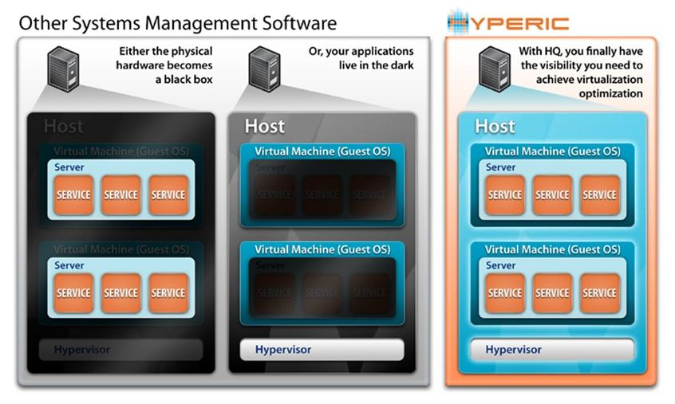
Need: Application Visibility Across Physical and Virtual Worlds

Slide 31
Hyperic Capabilities
Visibility into Applications and Infrastructure
More 50,000 metrics on more than 75 technologies at every layer of the stack
Ease-to-use UI to manage and monitor resources
Auto discovery of resources, services via Hyperic agents
Proactive Performance Management

Slide 32

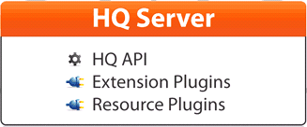


Hyperic Architecture Overview
User Interface
HQ Database

Slide 33
If You Can Measure It, You Can Manage It
Identify, Organize KPMs
Establish Baselines
Define Alerts, Automate Response
Define Escalation Workflows
Learn from Data

Slide 34
Demo – Hyperic

Slide 35
Is a New Style of Infrastructure Needed?
We need a platform that can Run these new apps.
Elastic App Server
Dynamic Load Balancing
Global Data Management
Performance Management
Developers & Architects
And… IT Operations
Cloud Messaging
Policy Driven Automation

Slide 36


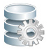



Application Infrastructure for the Cloud Generation
VMware vFabric Cloud Application Platform
Rich Web
Integration
Batch
Data Access
Social Media
Cloud APIs
Frameworks & Tools
Elastic
App Server
tc Server
Global Data Management
GemFire
Dynamic Load Balancer
ERS (Apache)
Performance Management
Hyperic
Policy-driven Automation
Cloud Messaging
vFabric AppDirector
RabbitMQ
vFabric
Platform Services
Virtual Datacenter
Cloud Infrastructure and Management

Slide 37
Licensing
Per-VM pricing for hardware independence
License based on average, not peak usage.
Usage tracked but not limited, in order to accommodate workload spikes.
Re-use licenses across different application tiers: web tier, app servers, data caches, databases, and message servers. For instance, you can initially deploy 10 vFabric Advanced VMs as application servers, then later re-deploy them as 10 database servers.

Slide 38
Questions?

